Slide 1
Clean Code

Slide 2
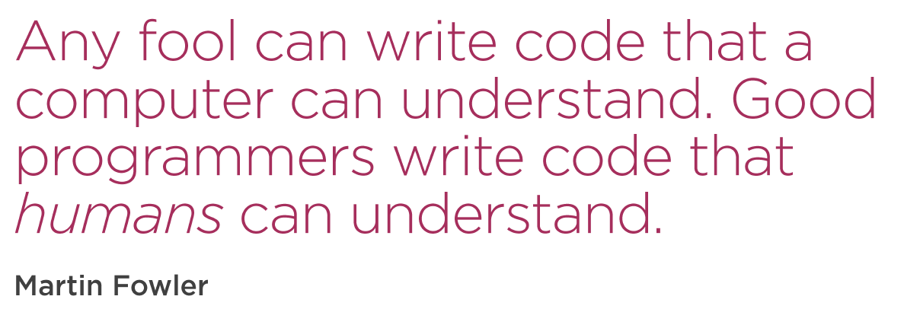

Slide 3
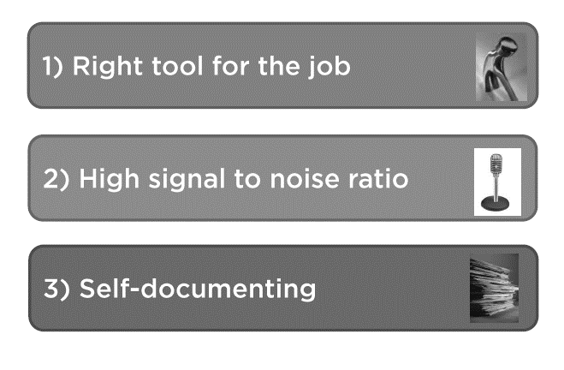
Principles

Slide 4

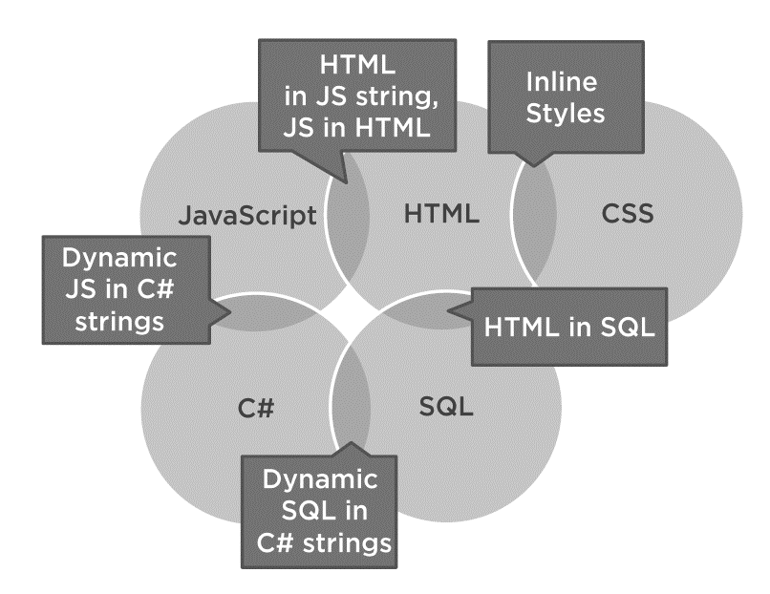
Stay Native
Avoid using VB.NET\C# strings to create
JavaScript
XML
HTML
JSON
CSS
Leverage Libraries
Principles # 1

Slide 5
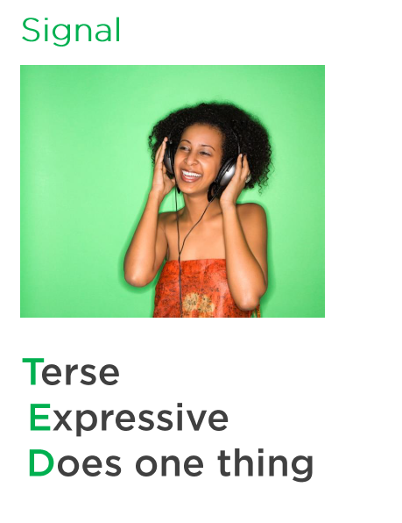
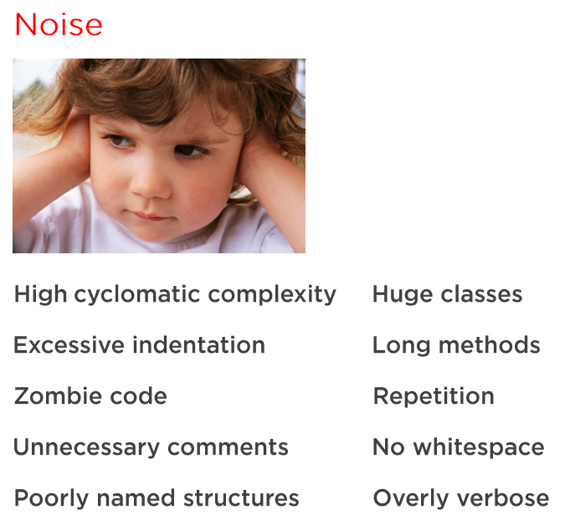
Principles # 2

Slide 6
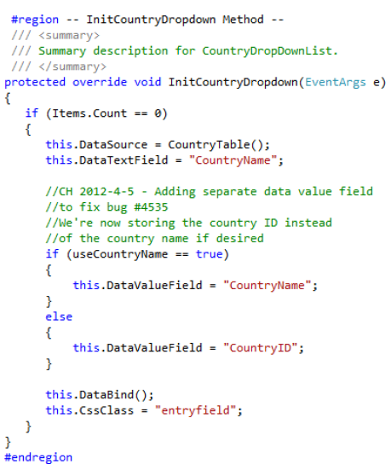
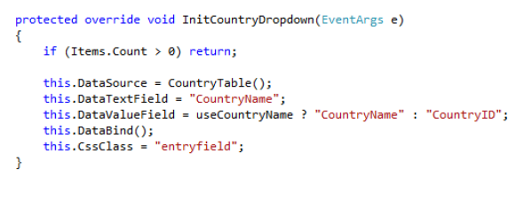
Signal to Noise Ratio Example

Slide 7
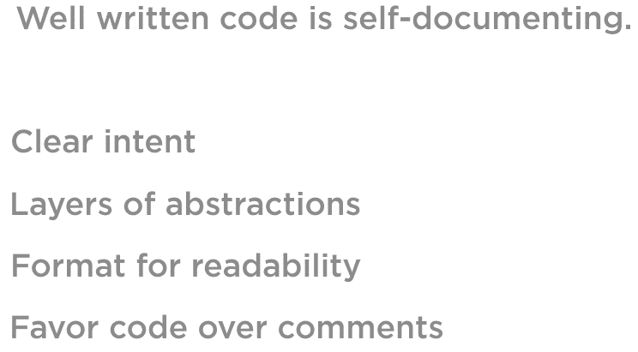
Self Documenting
Principles # 3

Slide 8
Naming Matters

Slide 9
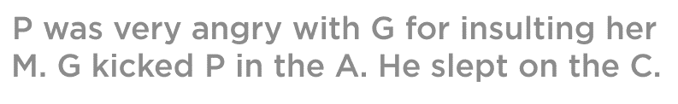

Can you read this?

Slide 10
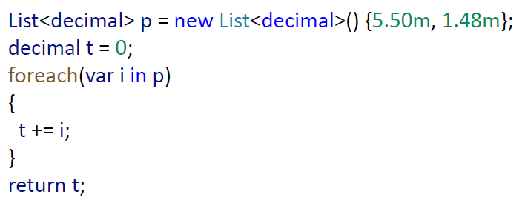
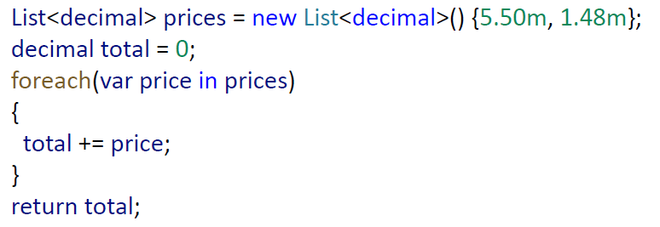

Can you read this?
What is p, t, I ?

Slide 11
Class Naming Guidelines
Noun
Be Specific
Single Responsibilities
Avoid Abbreviations

Slide 12
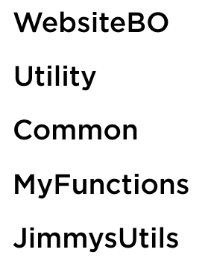
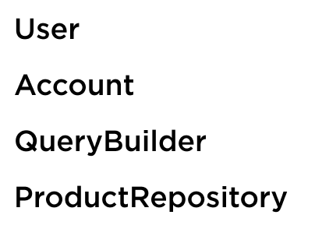
Class Naming Examples

Slide 13
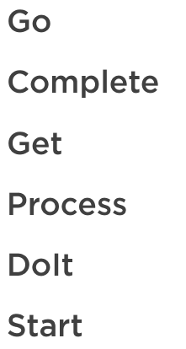
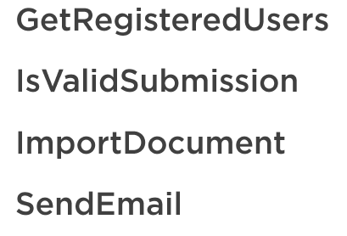
Method Naming Examples

Slide 14

Naming Warning Signs
And
If
Or

Slide 15
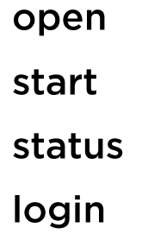
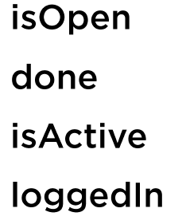
Variable Names

Slide 16
Conditions

Slide 17
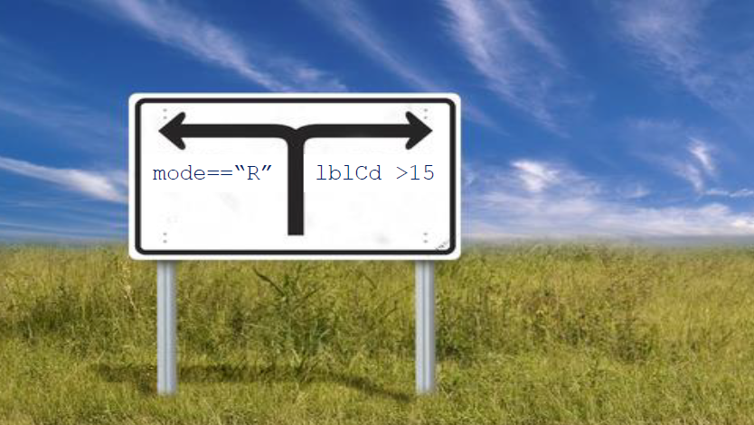
Original Programmer’s Intent is difficult to understand

Slide 18
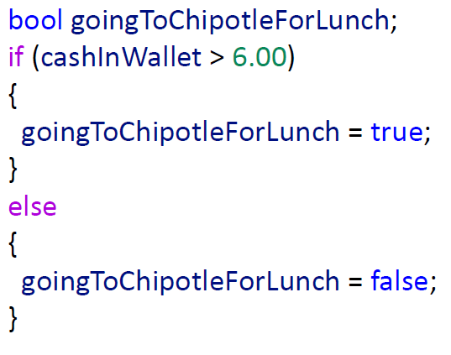
Assign Boolean Implicitly

Slide 19



Be Positive

Slide 20
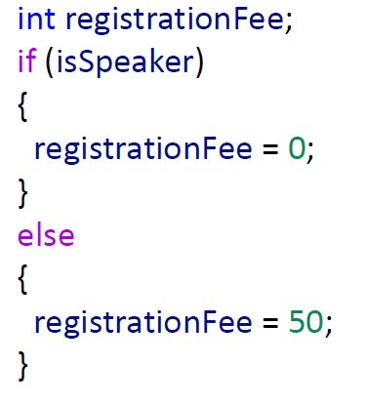

Ternary Is Beautiful

Slide 21

Be Strong Type

Slide 22
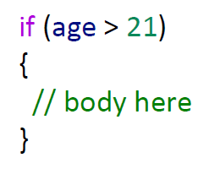
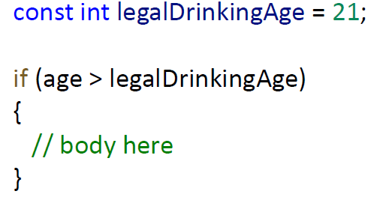
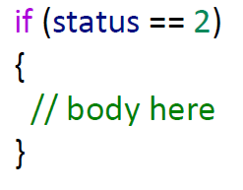
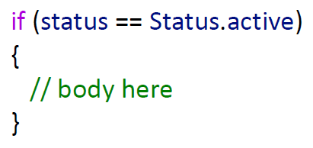
Magic Numbers

Slide 23
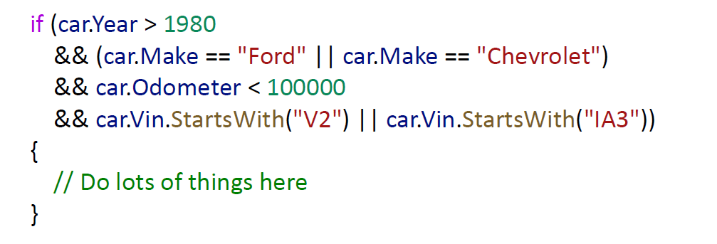
Complex Conditions
Let’s take an example of a complex IF condition
Intermediate Variables
Encapsulate via function

Slide 24
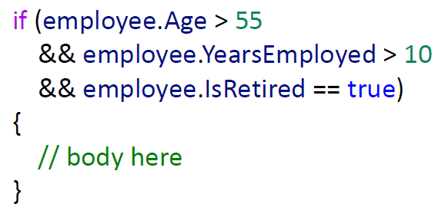
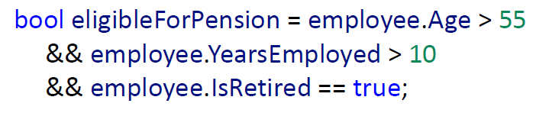
Intermediate Variables

Slide 25
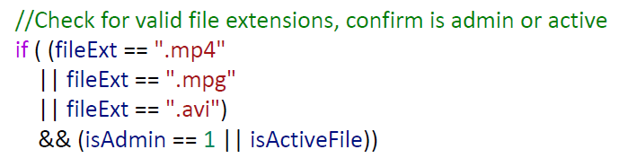
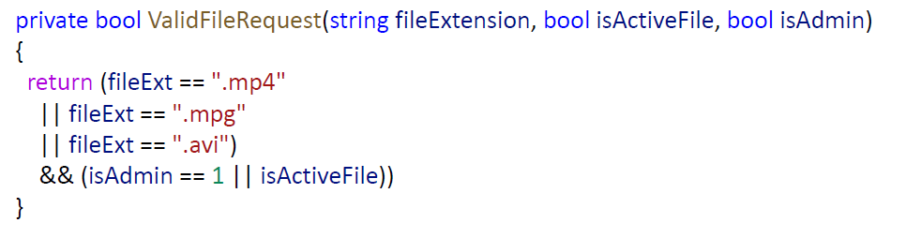
Encapsulate via function

Slide 26
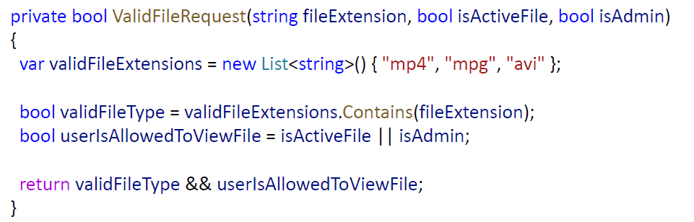
Encapsulate via function

Slide 27
Writing Clean Code Methods

Slide 28
When to Create Functions
Duplication
Indentation
Unclear Intent
> 1 task

Slide 29

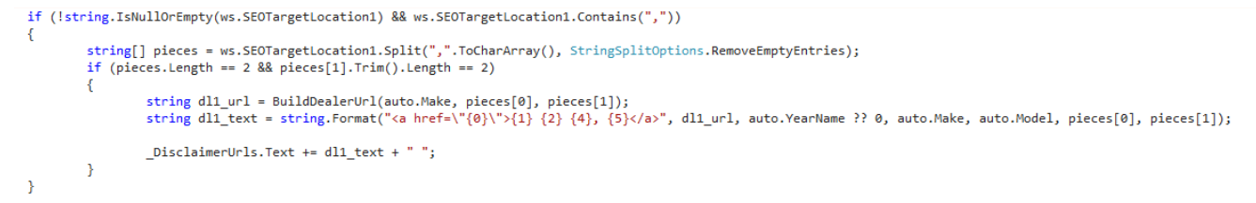
Duplication

Slide 30
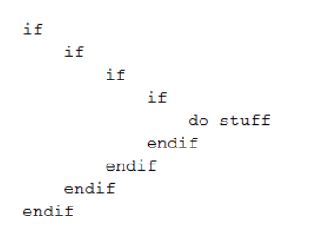
Excessive Indentation
Comprehension decreases beyond three levels of nested 'if' blocks
Arrow Code

Slide 31
Excessive Indentation
Excessive Indentation Solutions
Extract Method
Fail Fast
Return Early

Slide 32
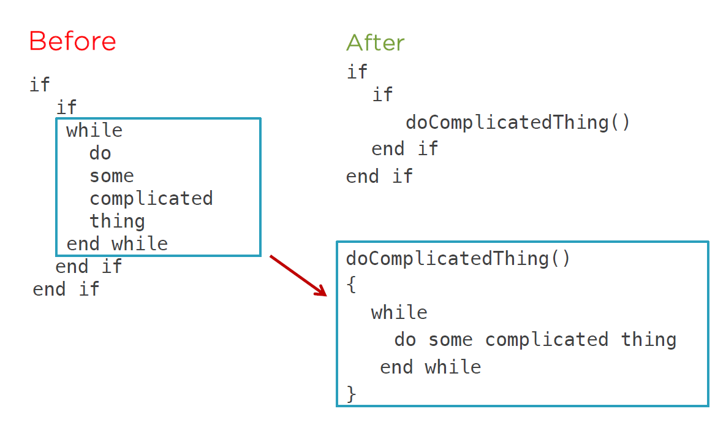
Extract Method

Slide 33
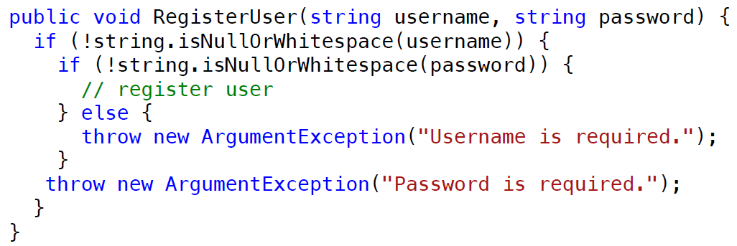
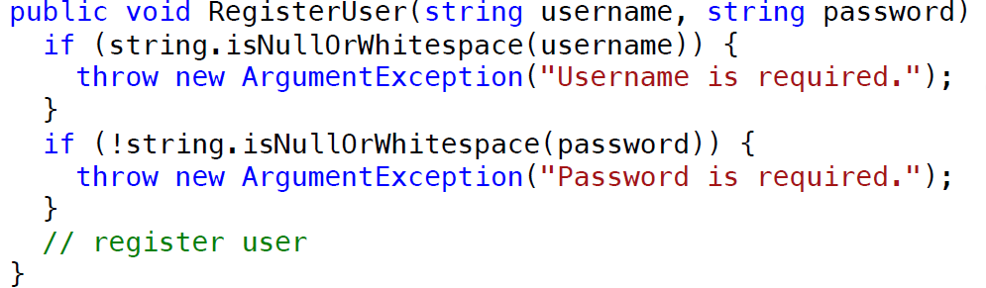
Fail Fast

Slide 34
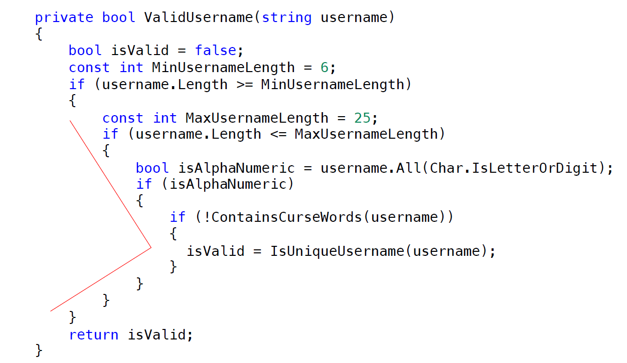
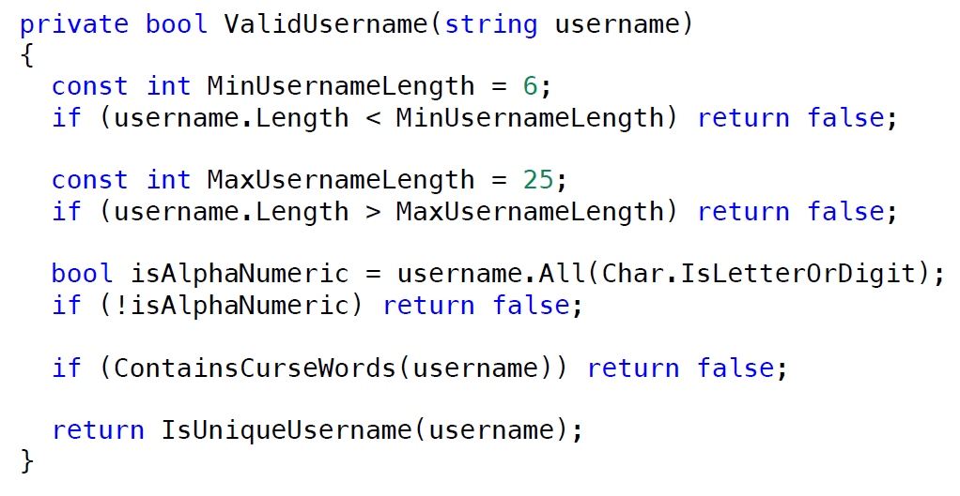
Return Early

Slide 35
Convey Intent

Slide 36
Do One Thing
Aid the reader
Promote the reuse
Ease naming and testing
Avoid Side Effects

Slide 37
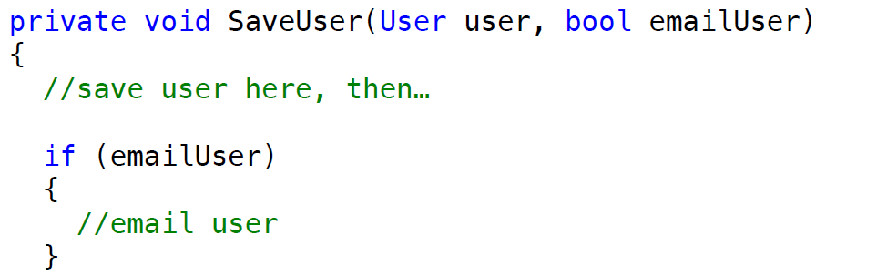
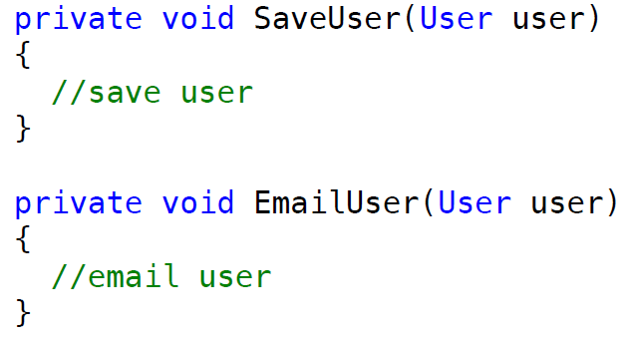
Honest Functions

Slide 38
Classes

Slide 39
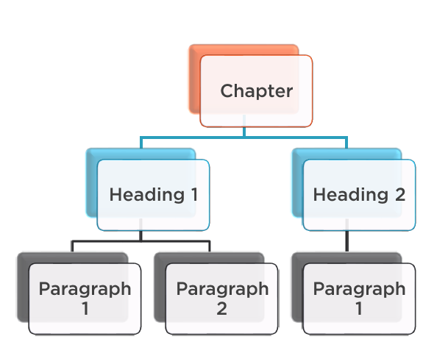
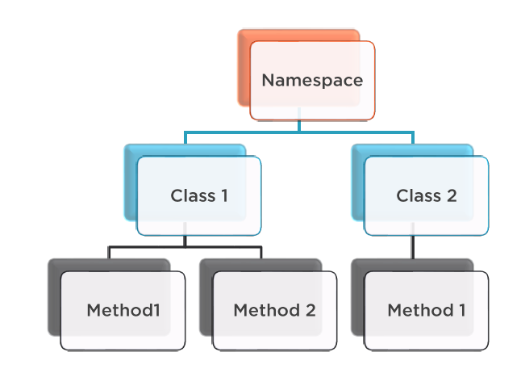
Classes Are Like Books Headings

Slide 40
When To Create a Class
New Concept
Low Cohesion
Promote Reuse
Reduce Complexity
Clarify Parameters

Slide 41
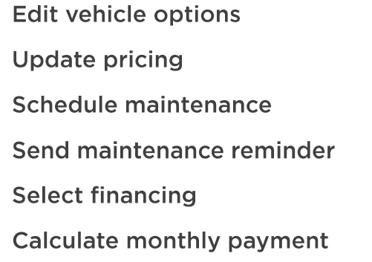
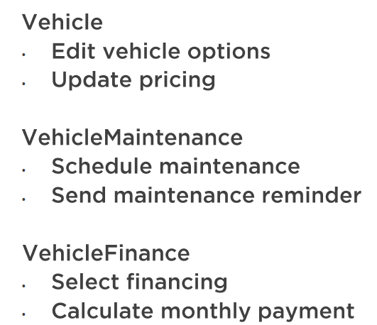
Low vs High Cohesion
High Cohesion
Low Cohesion

Slide 42

Primitive Obsession
Create a new User Class

Slide 43
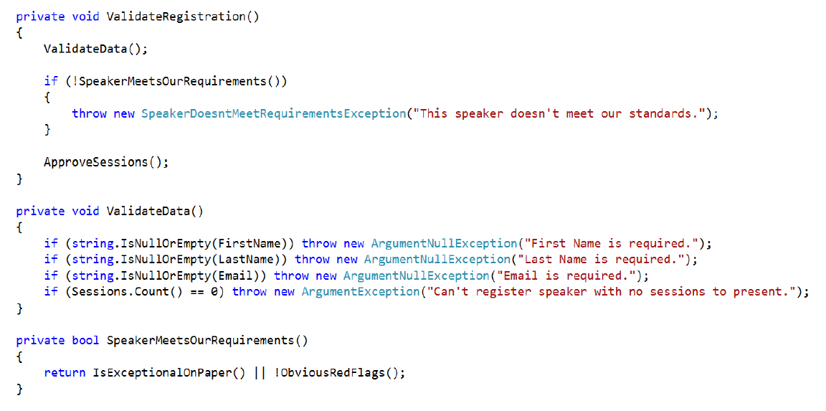
Proximity Principle
Make code read top to bottom when possible . Keep related actions together
1
2
1
2

Slide 44
THANK YOU

